Slide 1

University of Asia Pacific
Medicine Shop Management System
Database project
Submitted By:
Labanya Saha (21201059)
Md Al-Amin (21201061)
Md Mehadi Islam (21201065)
Jannatun Saumoon (21201066)
Paria Chowdury(21201067)
Course Code: CSE 212
Course Title: Database System Lab
Course Teacher: Molla Rashied Hussein

Slide 2
Introduction
Medicine Store Management System
Medicine Store Management System, refers to software designed to help a pharmacy or drug store list, sell, prescription and manage different aspects, including customer information.
Project Description
The Medicine Store Management System is a comprehensive software solution designed to streamline and optime the operations of a pharmaceutical store. This system offers features such as inventory management, sales tracking prescription management, and atomer records, it allows pharmacy carers and staff to efficiently manage their inventury serve customers better, and ensure compliance with regulations.

Slide 3
Tables & Attributes
Pharmacy
pharmacy_id
pharmacy_name
Pharmacy_address
pharmacy_contact
manufacturer_id
Customers
customer_id
customer_ name
customer_gender
customer_contact
customer_ age
customer_address

Slide 4

Prescription
prescription_id
customer_id
patient_name
medicine_name
quantity
Prescription_date
Medicine
medicine_id
medicine_name
medicine_type
medicine_quantity
medicine_price
expiry_date
manufacturer_id

Slide 5
Counter
counter_id
employee _id
pharmacy _id
Pharmacy_name
customer _id
medicine_id
Employee
employee_id
employee_name
employee_shift
job_title
counter_id
Manufacturer
manufacturer_id
manufacturer_name
manufacturer_address
manufacture_contact

Slide 6
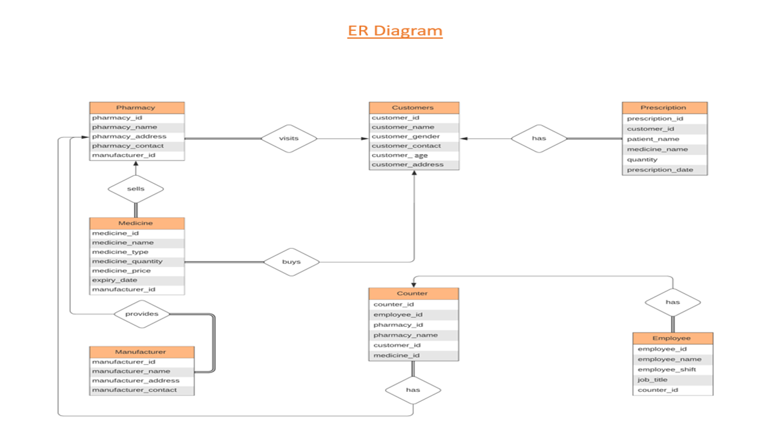

Slide 7
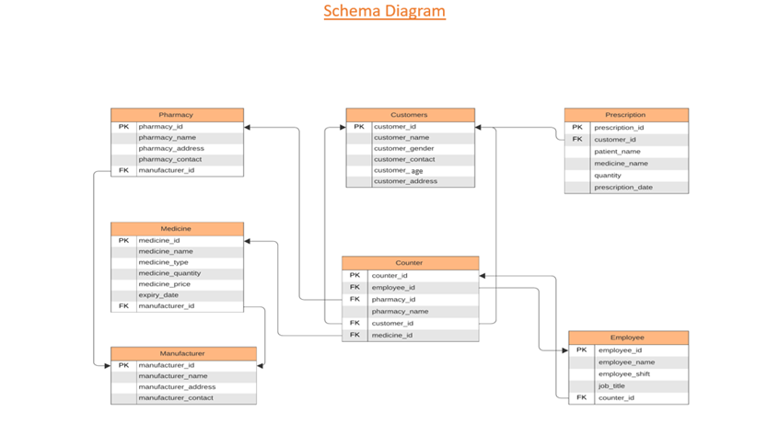

Slide 8
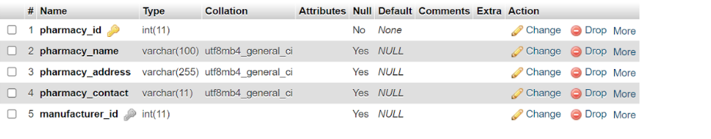
MEDICINE SHOP MANAGEMENT SQL PROJECT
Table structure for Pharmacy
CREATE TABLE Pharmacy (
pharmacy_id INT PRIMARY KEY,
pharmacy_name VARCHAR(100),
pharmacy_address VARCHAR(255),
pharmacy_contact VARCHAR(11),
manufacturer_id INT,
FOREIGN KEY (manufacturer_id) REFERENCES Manufacturer(manufacturer_id)
);

Slide 9
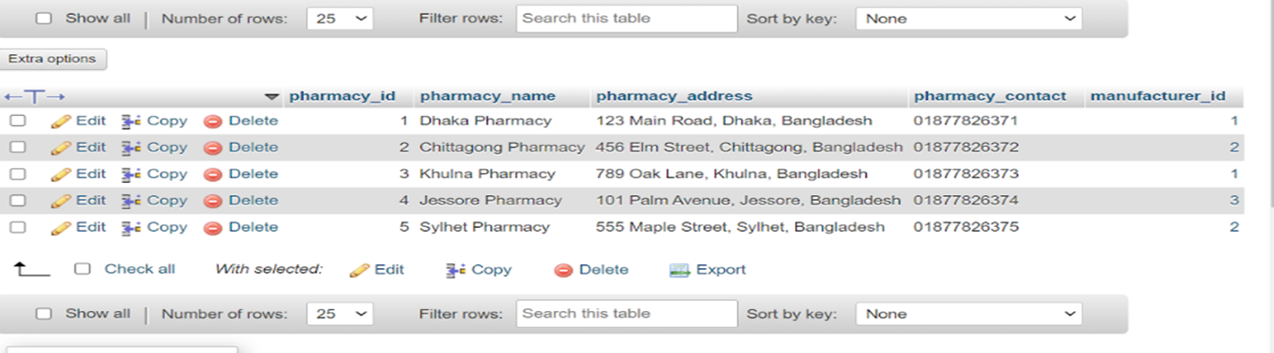

Slide 10
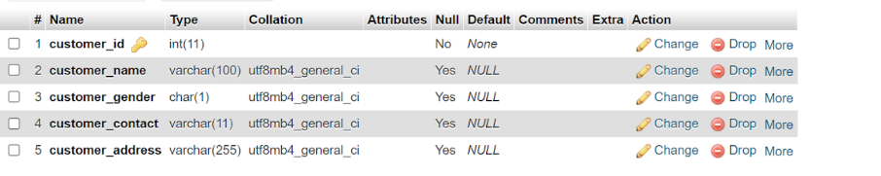
Table structure for Customers
CREATE TABLE Customers (
customer_id INT PRIMARY KEY,
customer_name VARCHAR(100),
customer_gender CHAR(1),
customer_contact VARCHAR(11),
customer_address VARCHAR(255)
);

Slide 11
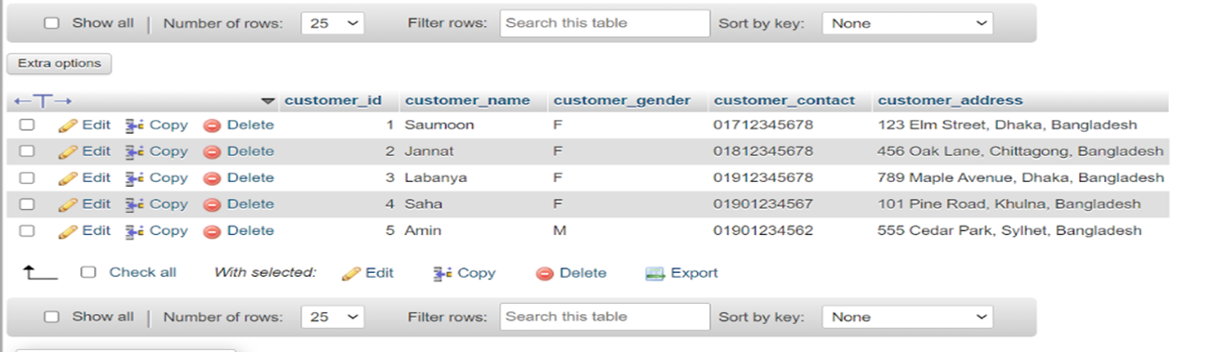

Slide 12
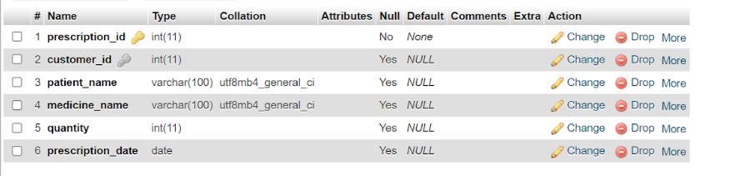
Table structure for Prescription
CREATE TABLE Prescription (
prescription_id INT PRIMARY KEY,
customer_id INT,
patient_name VARCHAR(100),
medicine_name VARCHAR(100),
quantity INT,
prescription_date DATE,
FOREIGN KEY (customer_id) REFERENCES Customers(customer_id)
);

Slide 13
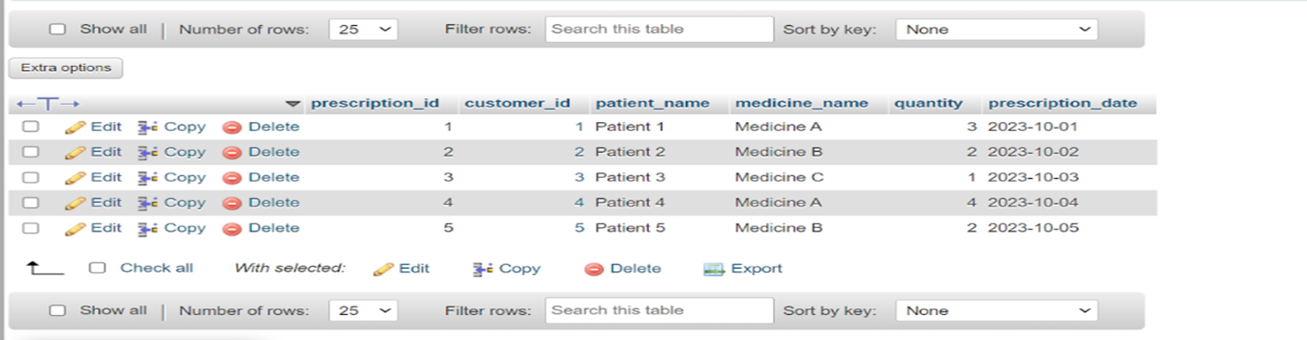

Slide 14
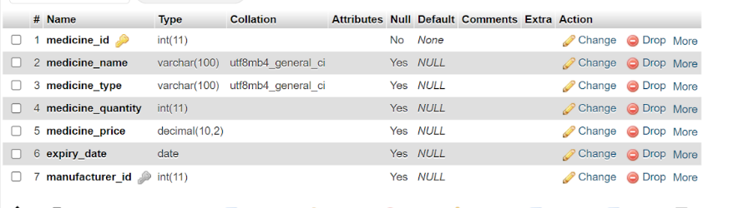
Table structure for Medicine
CREATE TABLE Medicine (
medicine_id INT PRIMARY KEY,
medicine_name VARCHAR(100),
medicine_type VARCHAR(100),
medicine_quantity INT,
medicine_price DECIMAL(10, 2),
expiry_date DATE,
manufacturer_id INT,
FOREIGN KEY (manufacturer_id) REFERENCES Manufacturer(manufacturer_id)
);

Slide 15
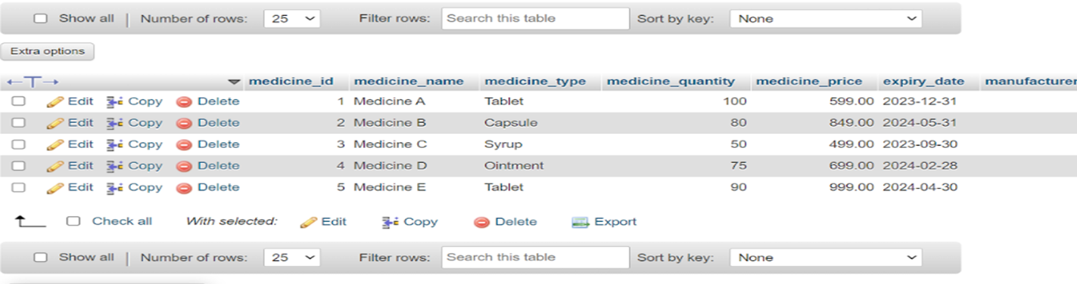

Slide 16
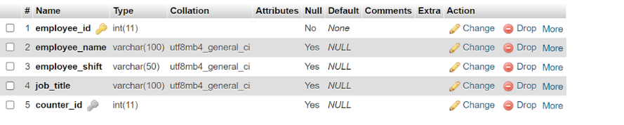
Table structure for Counter
CREATE TABLE Counter (
counter_id INT PRIMARY KEY,
employee_id INT,
pharmacy_id INT,
pharmacy_name VARCHAR(100),
customer_id INT,
medicine_id INT,
FOREIGN KEY (employee_id) REFERENCES Employee(employee_id),
FOREIGN KEY (pharmacy_id) REFERENCES Pharmacy(pharmacy_id),
FOREIGN KEY (customer_id) REFERENCES Customers(customer_id),
FOREIGN KEY (medicine_id) REFERENCES Medicine(medicine_id)
);

Slide 17
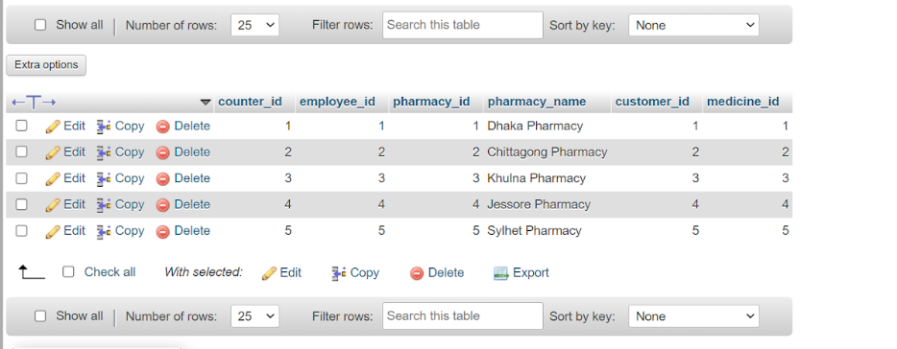

Slide 18
Table structure for Employee
CREATE TABLE Employee (
employee_id INT PRIMARY KEY,
employee_name VARCHAR(100),
employee_shift VARCHAR(50),
job_title VARCHAR(100),
counter_id INT,
FOREIGN KEY (counter_id) REFERENCES Counter(counter_id)
);

Slide 19
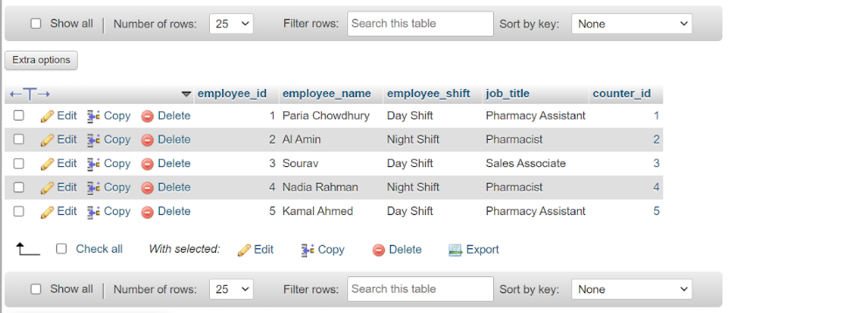

Slide 20
Table structure for Manufacturer
CREATE TABLE Manufacturer (
manufacturer_id INT PRIMARY KEY,
manufacturer_name VARCHAR(100),
manufacturer_address VARCHAR(255),
manufacturer_contact VARCHAR(11)
);

Slide 21
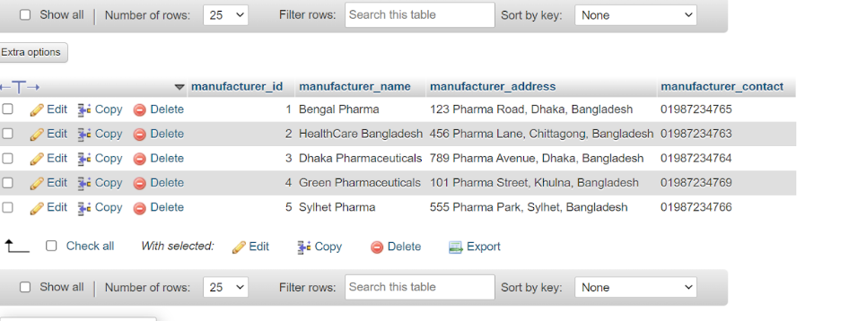

Slide 22
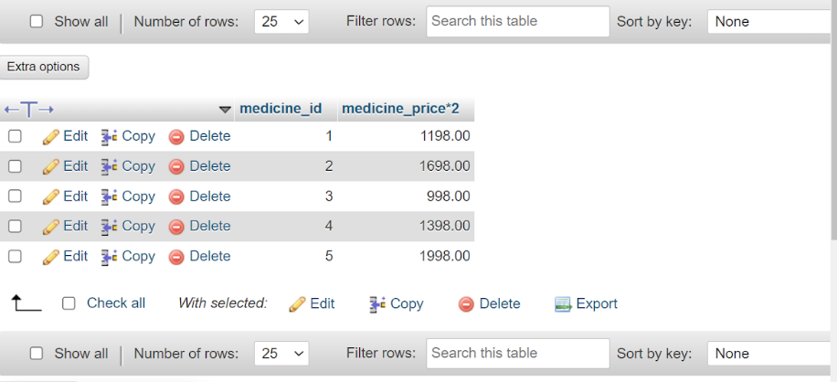
Query Writing
1.medicine price multiple query?
SELECT medicine_id,
medicine_price*2
FROM `medicine`

Slide 23
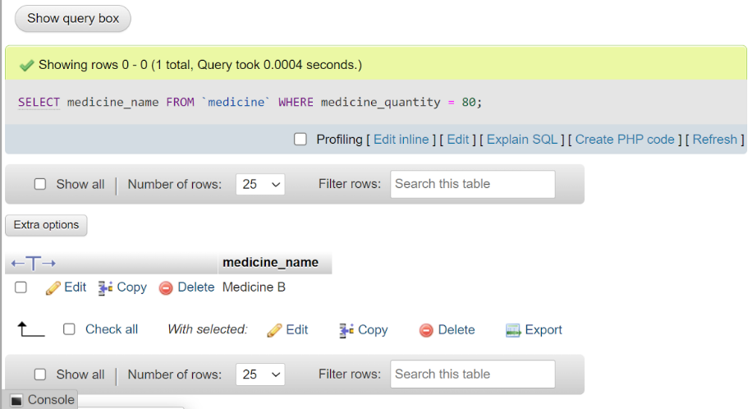
2.Where medicine quantity is 80?
SELECT medicime_name
FROM `medicine`
WHERE medicine_quantity=80;

Slide 24
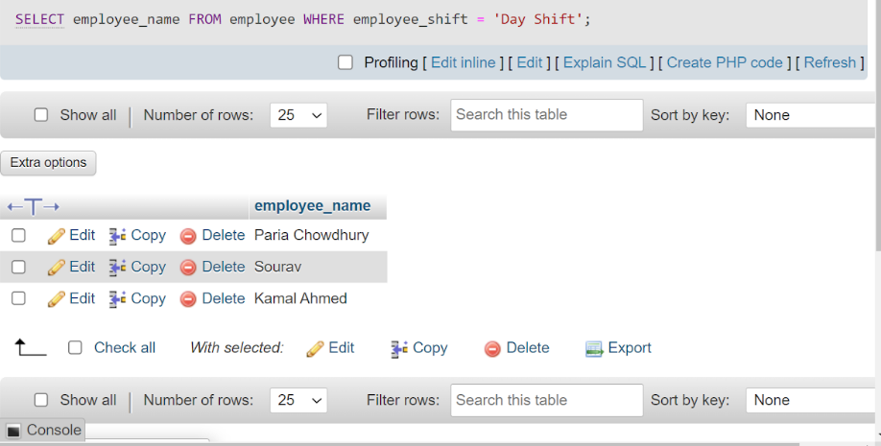
3.Dayshift employee name show?
SELECT employee_nameFROM employeeWHERE employee_shift='Day Shift';

Slide 25
Conclusion
In conclusion, the Medicine Store Management System represents a significant leap forward in the field of pharmaceutical management. This project combines the power of database and management systems to provide a user-friendly, efficient, and reliable solution for medicine store owners. It not only simplifies the daily operations but also enhances data security and accuracy, which are vital in the pharmaceutical industry. With this system, we have taken a step towards improving customer service, reducing errors, and maintaining a robust inventory. As a Computer Science student, this project demonstrates our ability to apply our knowledge and skills to real-world problems and create solutions that can have a positive impact on the healthcare sector. Thank you for your attention, and we look forward to any questions or feedback you may have.

Slide 26


